Slide 1
World Cup Match Predictor & Analyst Chatbot
Group 8 | Track 1
LangChain · Gemini 2.5 Flash · FAISS · Plotly
Notes:
Hey everyone, we're Group 8. We built a chatbot that lets you ask questions about World Cup history and get match predictions backed by real data.

Slide 2




What We Built
• World Cup stats are scattered across the internet
• We wanted a single place where you can just ask questions in plain English
• 'What happened in the 2014 final?' → gets the actual result
• 'Predict Brazil vs Germany' → gets a full report with stats
Notes:
The idea was pretty simple. World Cup data is out there but it's all in spreadsheets and random websites. We wanted something where you just type a question and get a real answer with numbers behind it, not just an LLM making stuff up.

Slide 3
Architecture
• User types a question
• LangChain ReAct Agent (Gemini 2.5 Flash) processes input
• Agent routes to 6 distinct tools (Discovery, Ingestion, Retrieval, Reasoning, Synthesis, Report)
• ConversationBufferMemory remembers user preferences
Notes:
We have 6 tools and the agent picks which ones to use on its own. If you ask about history, it searches the vector database. If you ask for a prediction, it runs head-to-head stats first, then passes that into the report generator. The memory piece means if you tell it your favorite team, it remembers that for the next question.

Slide 4
Data Pipeline
• Source: International Football Results (GitHub/Kaggle)
• 49,000 total matches → filtered to 964 World Cup matches
• Each match converted to text → embedded → stored in FAISS
• Auto-downloads on first run, FAISS index cached to disk
Notes:
We pulled about 49,000 international match results and filtered down to 964 actual World Cup matches from 1930 to 2022. Each match gets turned into a sentence describing who played, the score, and where it happened. Those get embedded and stored in FAISS so the agent can search through them. The whole thing downloads automatically and caches itself.

Slide 5
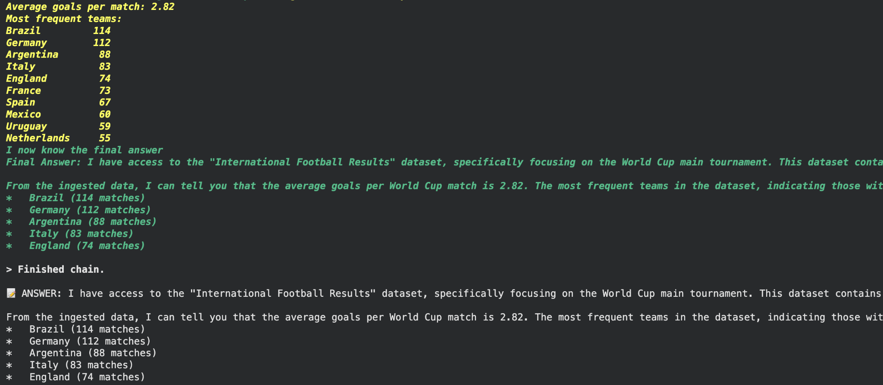
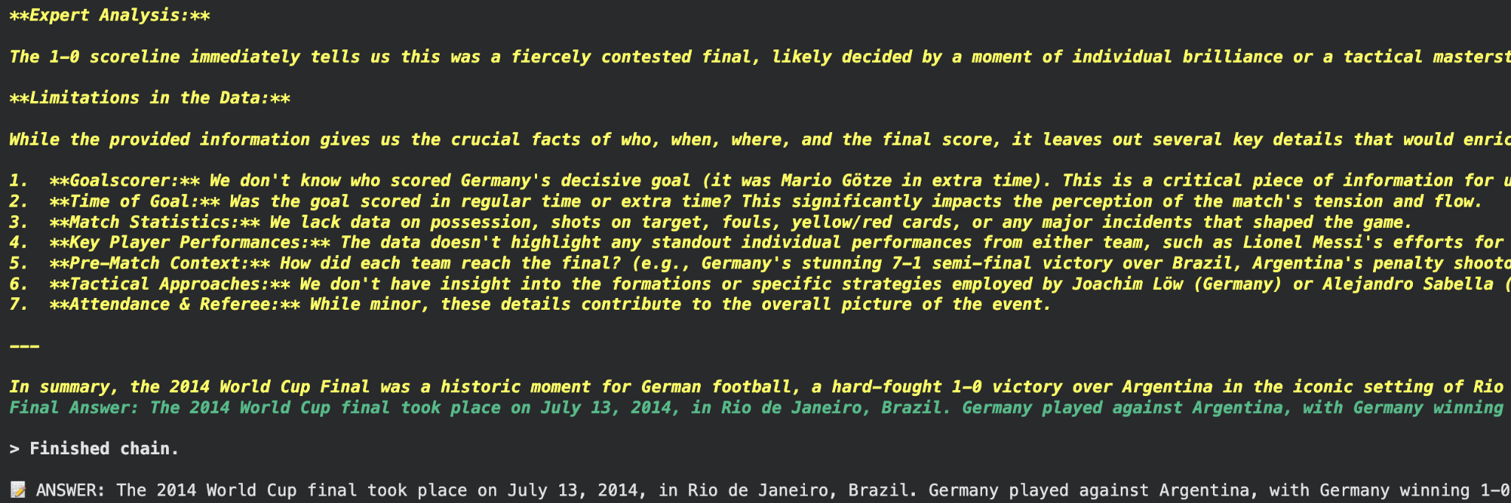
Demo — Historical Queries
Dataset Discovery
2014 World Cup Final RAG Retrieval
Notes:
So here's the first test. We ask what data is available and the agent calls two tools — discovery and ingestion — and gives us the breakdown. Then we ask about the 2014 final and it actually pulls the match record from the vector database. Germany beat Argentina 1-0 in Rio. This isn't the LLM guessing — it's pulling from real stored data.

Slide 6
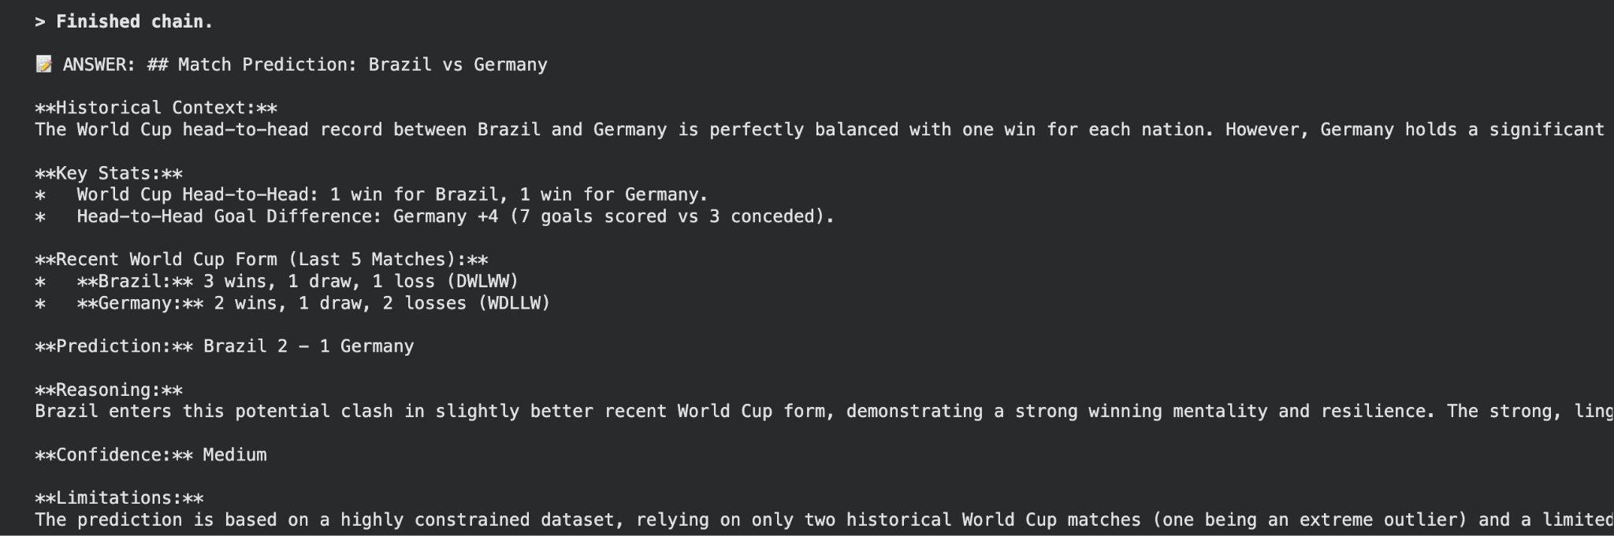
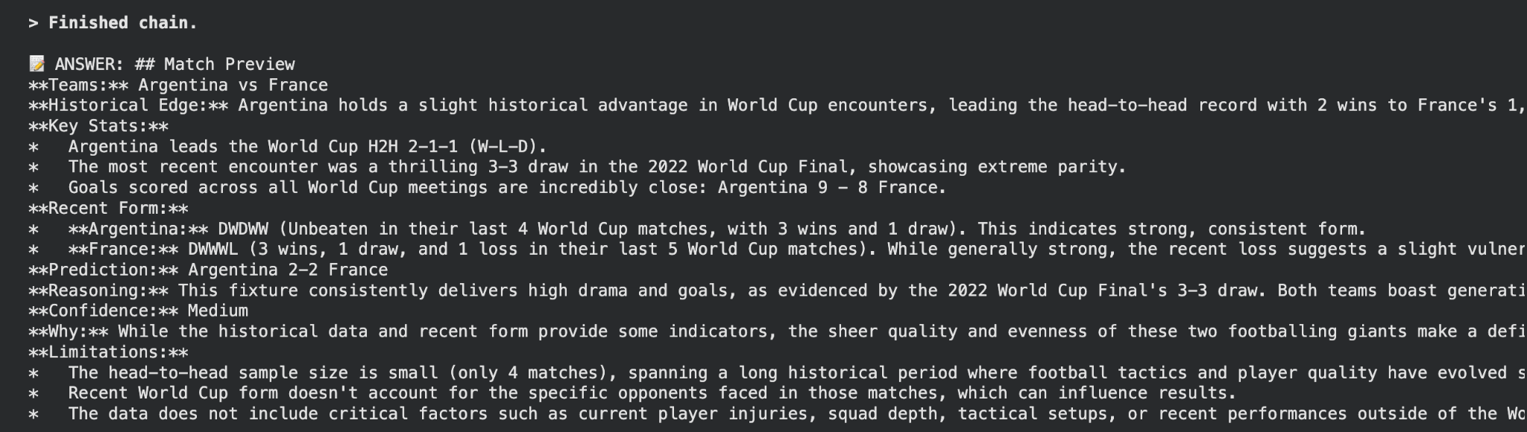


Demo — Predictions & Memory
Brazil vs Germany Prediction Report
Argentina vs France Memory Recall
Notes:
This is the prediction test. We ask for Brazil vs Germany and the agent runs head-to-head analysis, checks recent form, and gives us a structured prediction with a confidence level. It even lists what the data can't tell us. Then for the memory test — I tell it my favorite team is Argentina, and in the next message I just say 'my team' and it knows I mean Argentina. It runs the full prediction for Argentina vs France.

Slide 7
Visualizations & Innovation
• Interactive Plotly goal history charts for any team
• Prediction reports with confidence + limitations
• Conversation memory across turns
• Streamlit app included (app.py)
Notes:
We also added interactive charts showing goals for and against across every World Cup. These are for Brazil, Argentina, and Germany. You can see that spike in Germany's 2014 goals against — that's the 7-1 against Brazil. We also built a Streamlit app, though the Gemini free tier made it slow for live demo, so we included it as app.py in the submission.

Slide 8
Limitations & What We Learned
Limitations:
• No player-level data (injuries, current form)
• Predictions are purely historical
• Gemini free tier = 5 requests/min
What we learned:
• ReAct agents can pick their own tools based on the question
• RAG with FAISS keeps answers grounded in real data
• Memory makes the chatbot feel like an actual conversation
Notes:
A few honest limitations — we don't have player data, so injuries and current form aren't factored in. And the free Gemini tier only gives 5 requests per minute which slowed things down. But what we took away from this is that the ReAct pattern works really well for routing different types of questions to different tools, and RAG keeps the answers honest. Thanks — happy to take any questions.

